Slide 1
CALD Lab #1 Introduction to VVM
ENGR.RAMSHA MASHOOD

Slide 2
Visible Virtual Machine
The Visible Virtual Machine (VVM) is based on a model of a simple computer device called the Little Man Computer which was originally developed by Stuart Madnick in 1965, and revised in 1979.
The VVM is a virtual machine because it only appears to be a functioning hardware device. In reality, the VVM “hardware” is created through a software simulation.

Slide 3
VVM Editor
VVM includes a fully functional Windows-style VVM Program Editor for creating and manipulating VVM programs.
The editor provides a program syntax validating facility which identifies errors and allows them to be corrected.
Once the program has been validated, it can be loaded into the VVM Virtual Hardware.

Slide 4
VVM Data
For simplicity, VVM works directly with decimal data and addresses rather than with binary values.
Furthermore, the virtual machine works with only one form of data: decimal integers in the range ± 999

Slide 5
Using VVM
When using VVM, the user is given total control over the execution of his or her program.
Execution speed of the program can be increased or decreased via a mousen driven speed control.
The program can be paused and subsequently resumed at any point, at the discretion of the user. Alternatively, the user can choose to step through the program one statement at a time.

Slide 6
Hardware Components
I/O Log
Accumulator Register (Accum).
Instruction Cycle Display
Instruction Register
Program Counter Register
RAM

Slide 7
Data and Addresses
All data and address values are maintained as decimal integers. The 100 data-word memory is addresses with two-digit addressed in the range 00-99. Each memory location holds one data-word which is a decimal integer in the range -999 - +999. Data values beyond this range cause a data overflow condition and trigger a VVM system error.

Slide 8
Trace View
The Trace View window provides a history of the execution of your program. Prior to the execution of each statement, the window shows:
1. The instruction cycle count (begins at 1)
2. The address from which the instruction was fetched 3.
The instruction itself (in VVM Assembly Language format)
4. The current value of the Accumulator Register

Slide 9
VVM System Errors
Data value out of range
Undefined instruction
Program counter out of range
User cancel

Slide 10
VVM Commands/Instructions
Input: (901) [IN] (or [INP]) A value input by the user is stored in the Accumulator Register,
Output: (902) [OUT ] (or [PRN]) The content of the Accumulator Register is output to the user.
Load Accumulator (5 nn) [LDA ] The content of RAM address nn is copied to the Accumulator Register.
Add (1 nn) [ADD nn] The content of RAM address is added to the content of the Accumulator Register
Subtract (2 nn) [SUB nn] The content of RAM address is subtracted from the content of the Accumulator.
Halt (000) [HLT] (or [COB]) Program execution is terminated.

Slide 11
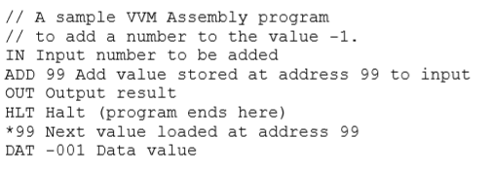
VVM Program Example 1
A simple VVM Assembly Language program which adds an input value to the constant value -1 is shown below

Slide 12
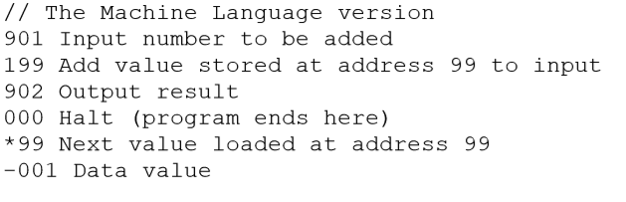
VVM Machine Language
This same program could be written in VVM Machine Language format as follows:

Slide 13
VVM download link
https://visible-virtual-machine.software.informer.com/5.0/
Refer to lab manual to see step by step guide of VVM Editor to run the above program.

Slide 14
LAB TASKS
1. To take input and Subtract.
2. To take two input as hardcore and Add them.

